Slide 1
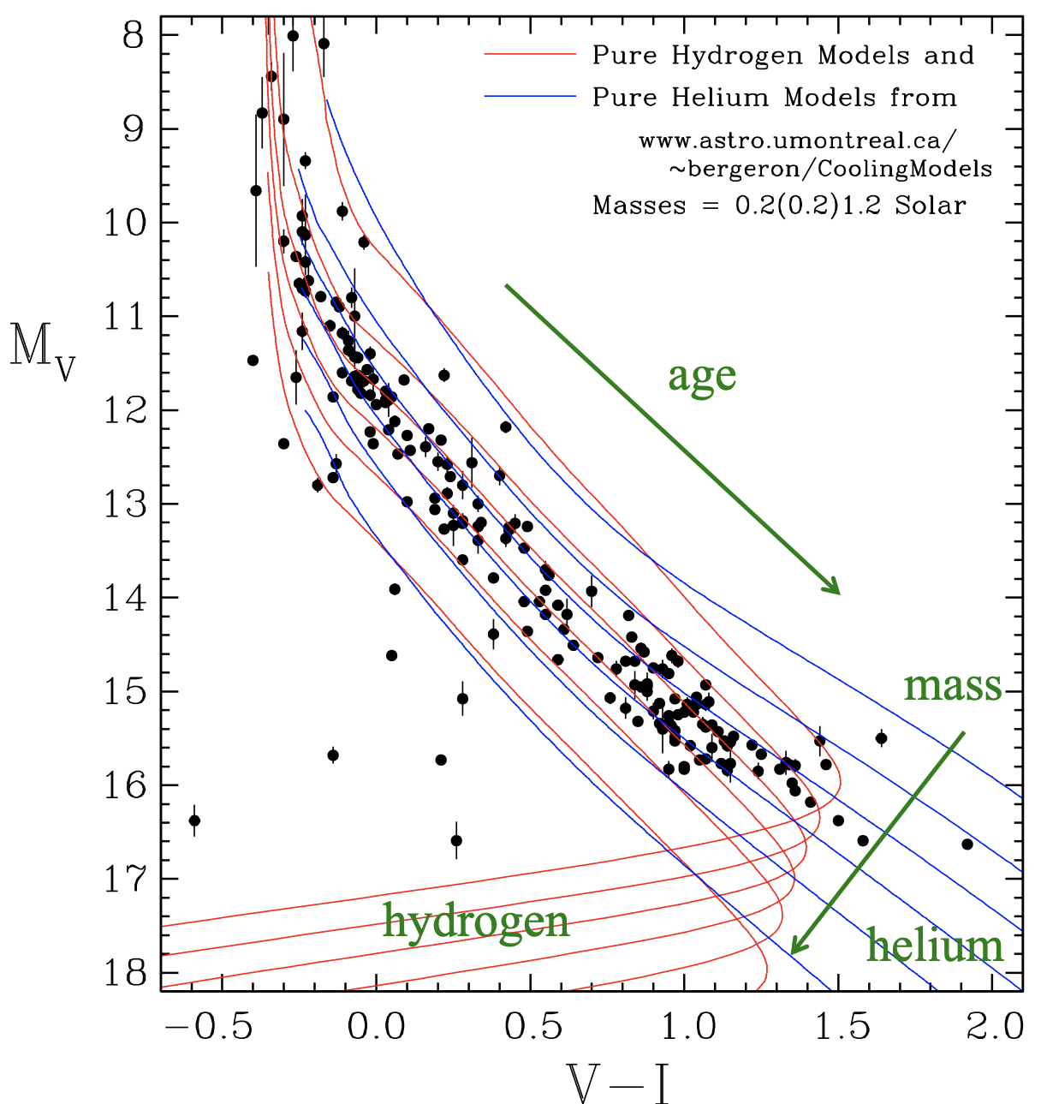
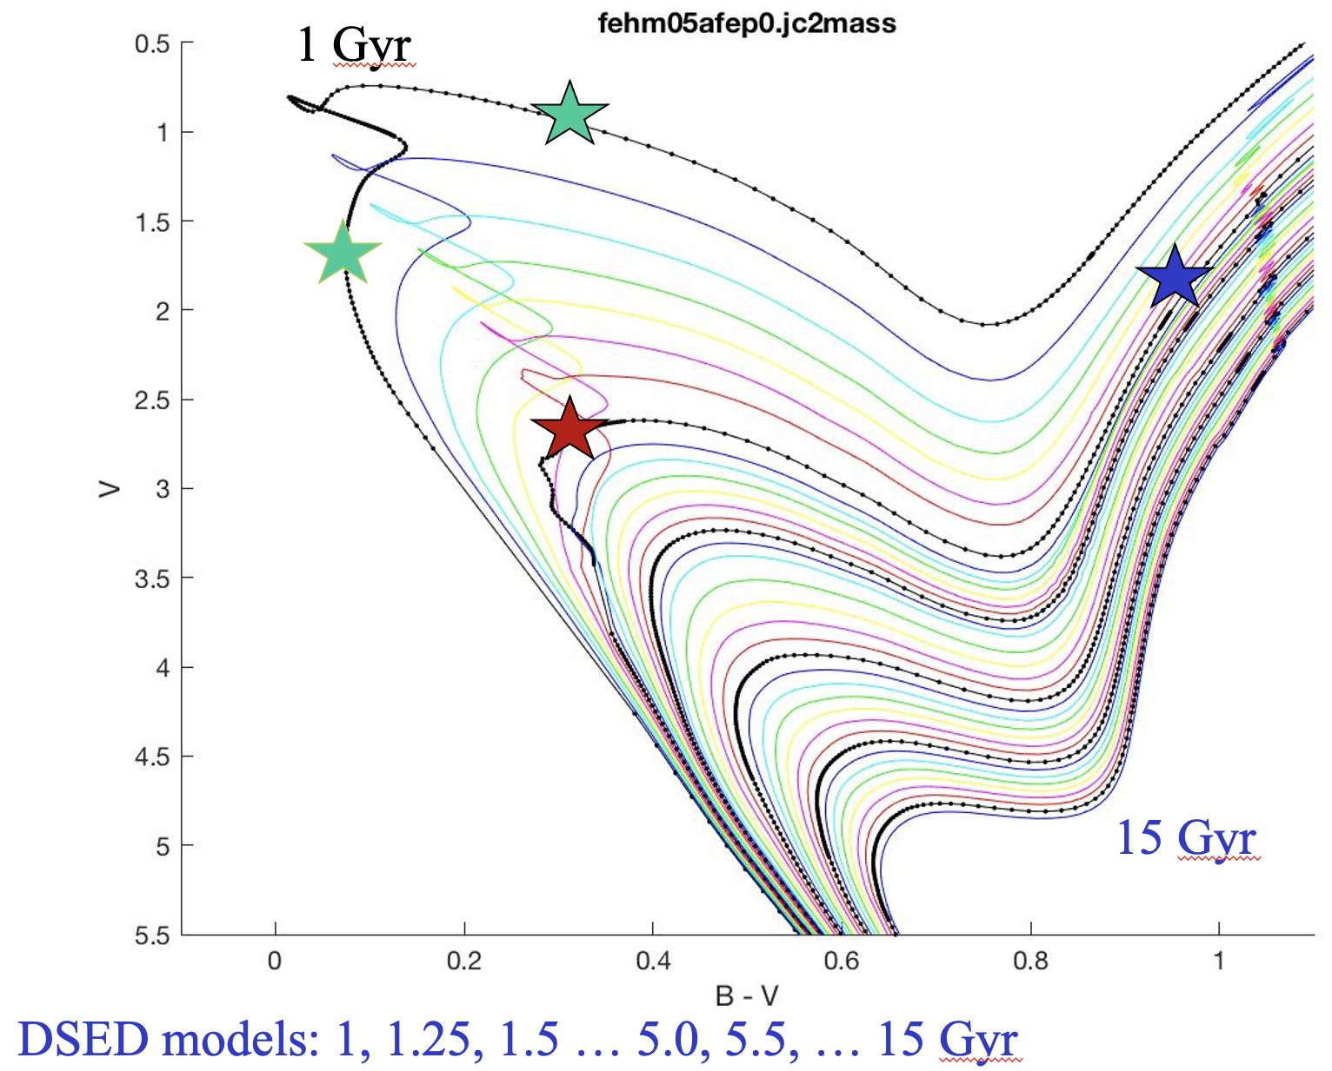
Bayesian Analysis of Stellar Evolution (BASE-9): stars, binaries, open and globular clusters, simulations
Ted von Hippel (Embry Riddle Aeronautical Univ)
Astrostatistics in Canada and Beyond Oct 30, 2023
Notes:
Left-hand insert from from Hugh Harris: “160 WDs with new or improved USNO parallaxes (in prep)”

